Slide 1
EEEN 311 Logic Circuits & Microprocessors
Emu8086 Tutorial

Slide 2
ABOUT 8086 and emu8086
8086 is a 16-bit Intel microprocessor.
The 8086 gave rise to the x86 architecture, which eventually became Intel's most successful line of processors.
Therefore, learning the programming skills of 8086 is a good start for the ones who interest low level programming of Intel processors.
Emu8086 is an emulator that simulate 8086 microprocessor on your computer. It can be regarded as a Virtual PC.
This emulator has much easier syntax than the other emulators and their visual interface is very helpful.
Therefore it is very suitable for the beginners.

Slide 3
INSTALLING emu8086
Here is the link that provides free trial of emu8086
https://emu8086-microprocessor-emulator.en.softonic.com/
When click download for windows, it tries to download avast.
Click cancel and it moves on to next page and automatically downloads emu8086.
If it doesn’t automatically download, click download windows, this time it will download emu8086.

Slide 4
STARTING emu8086
After the installation we are ready to use emulator
Click the emu8086.exe (has a green icon)
After the trial info, a window should be opened that involve ‘new’, ‘code examples’, ‘quick tutor’ icons. For writing a new code click new.
Then you should select the extension of the file that you write. Select COM
Now we are ready to start

Slide 5
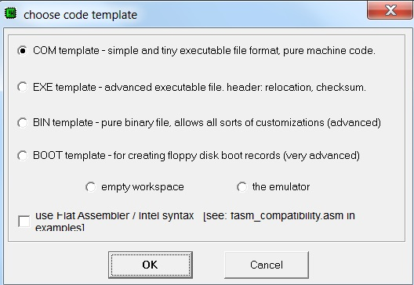
STARTING emu8086
Then you should select the extension of the file that you write. Select COM
Now we are ready to start

Slide 6
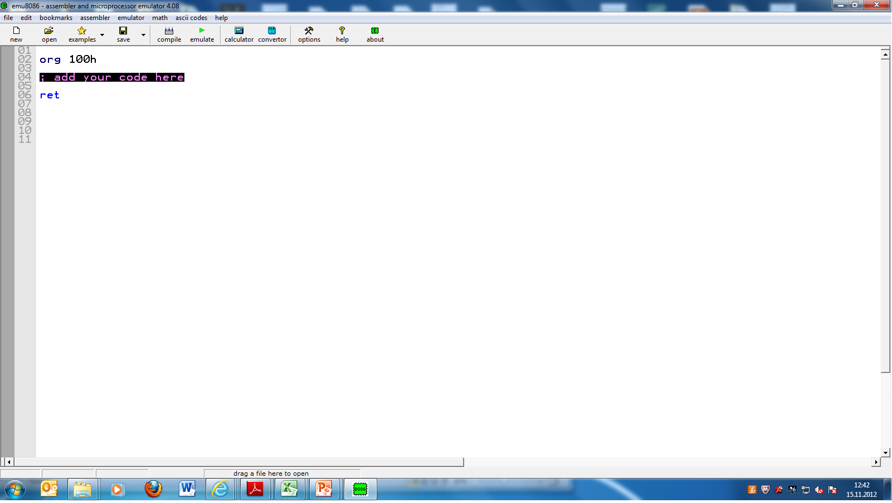
STARTING emu8086

Slide 7
STARTING emu8086
As you see, org 100h and ret codes are written by default.
Org 100h means that your code starts with CS:0100. In other words it corresponds to the Instruction pointer.
Ret means that the code is written up to that line.
There are some tools that can be useful such as calculator and convertor
These tools can help you to convert and calculate numbers in binary, octal, decimal, and hexadecimal cases.

Slide 8
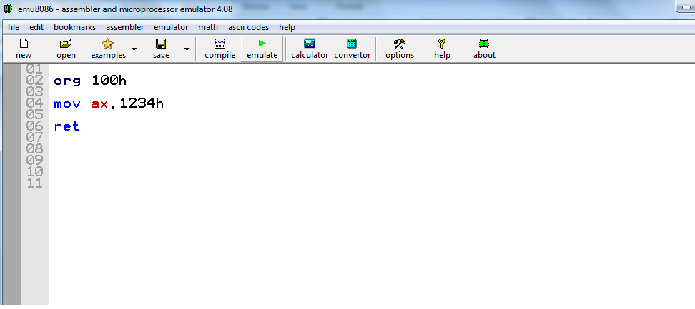
PROGRAMMING IN emu8086
We are ready to write some simple programs and observe the results.
Suppose we want to store 1234h number into AX accumulator.

Slide 9
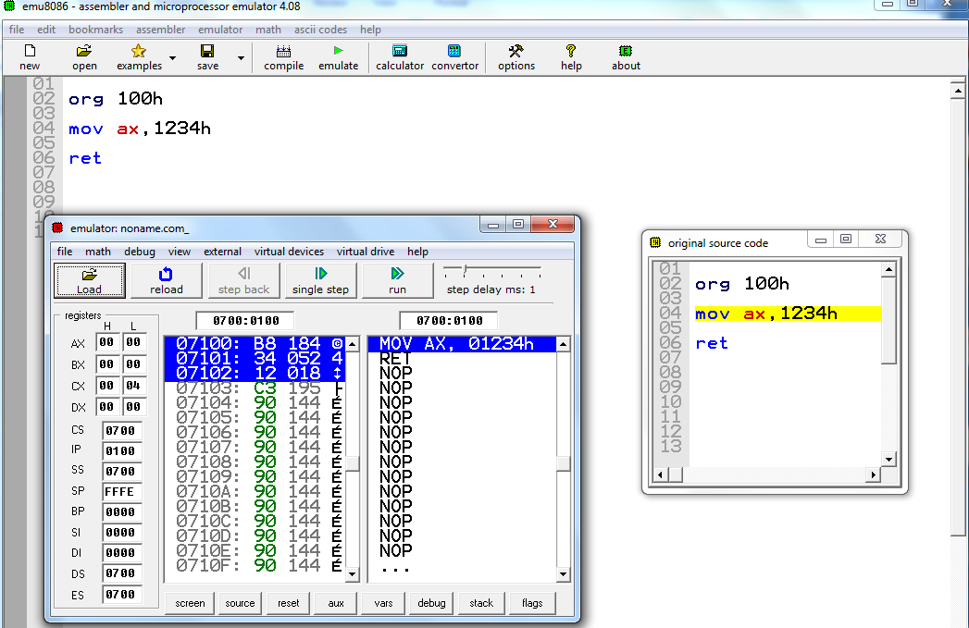
PROGRAMMING IN emu8086
Note that if you just write 1234 instead of 1234h, then emulator thinks that this number is decimal.
Now click the emulate button, The new window demonstrates your code in the memory and the values of registers before your code run. Note that AX is 0000h before our code run

Slide 10
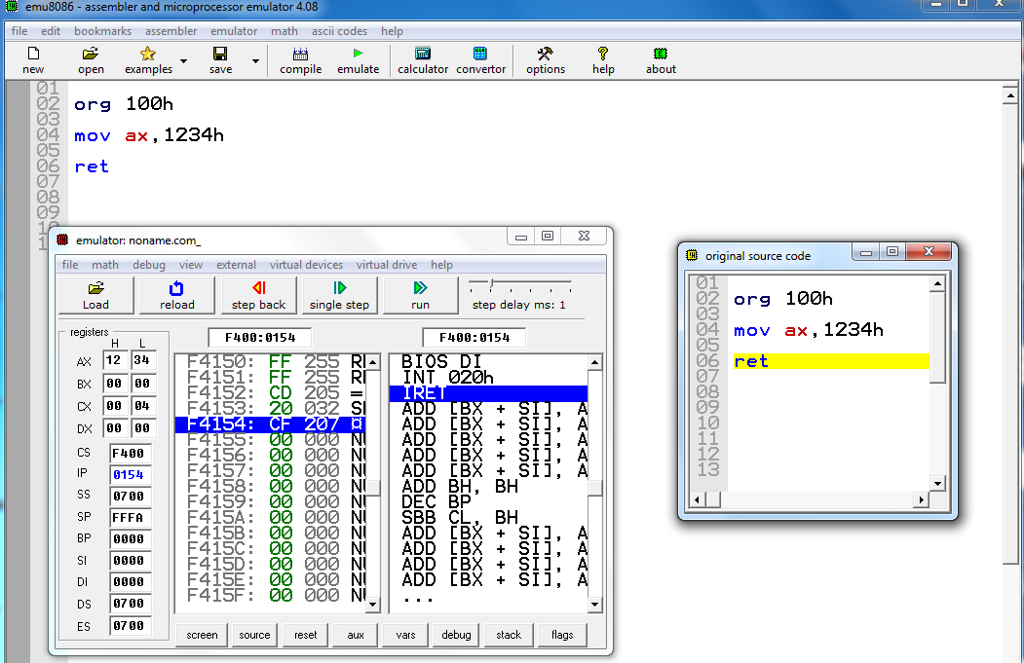
PROGRAMMING IN emu8086
If you do not receive any error message, click run.
You should receive ‘the program has returned to the control operating system’ then your code works well and you will see that the value of AX will be 1234.

Slide 11
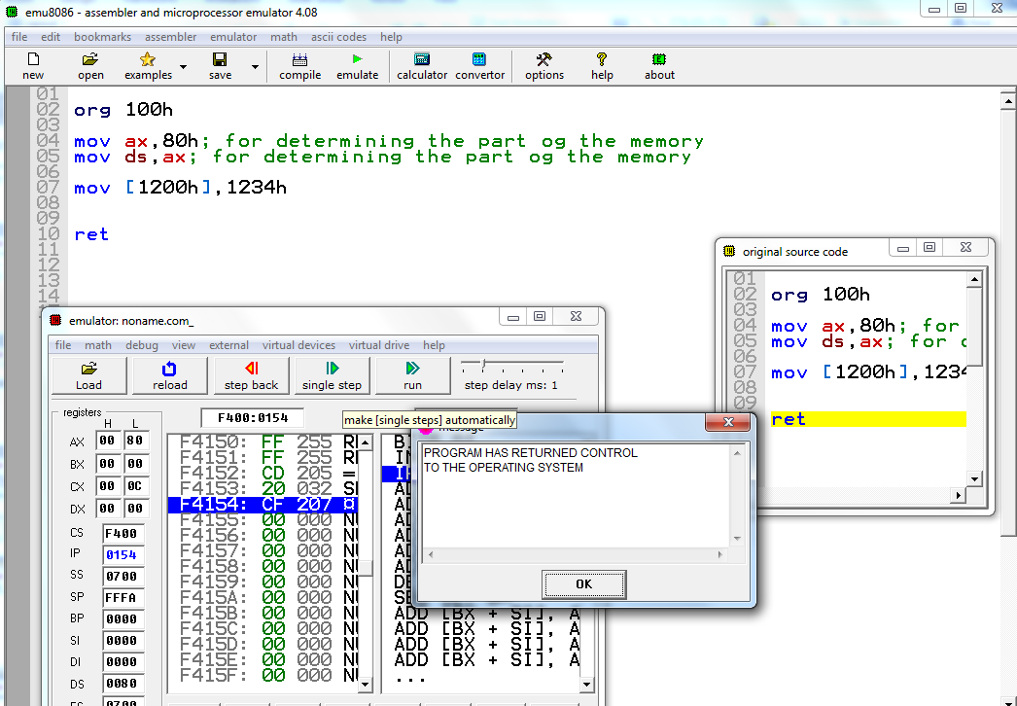
PROGRAMMING IN emu8086
Now we are going to use the memory of the 8086.
Suppose we want to store 1234h value inside the memory 0080:1200

Slide 12
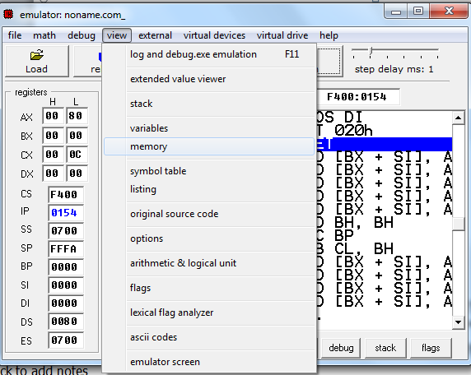
PROGRAMMING IN emu8086
As you see the code is correctly written and executed.
But how can we check the memory 0080:1200?
Click view and then click memory.

Slide 13
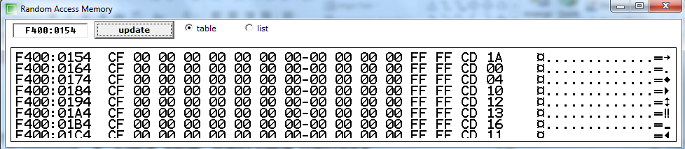
PROGRAMMING IN emu8086
Now the values in the memory are available for us.
The visible memory starts from F400:0154 as indicated but we need to look at the address 0080:1200.

Slide 14
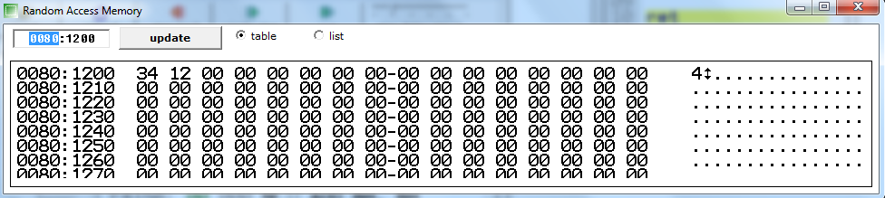
PROGRAMMING IN emu8086
We type 0080:1200 address box and we observe that the desired value has been stored inside the memory.
Note that the address of 0080:1200 involve 34 and 0080:1201 involve 12. This implies little endian convention.

